Slide 1
Getting Started with VIS
Gopala Krishna Reddy Achieve

Slide 2
Outline
Installing VIS
Changes to be made in the verilog code
Demo

Slide 3
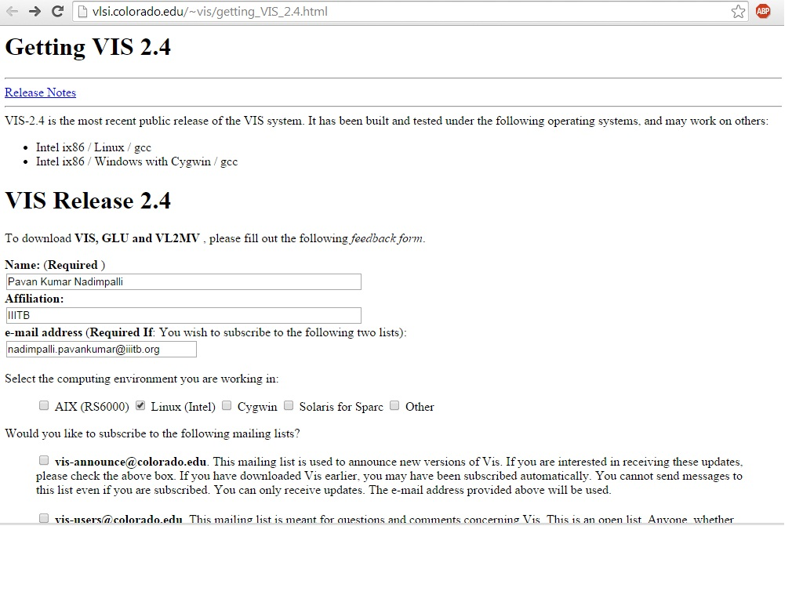
Getting VIS
Download the files VIS, GLU, VL2M from http://vlsi.colorado.edu/~vis/getting_VIS_2.4.html

Slide 4
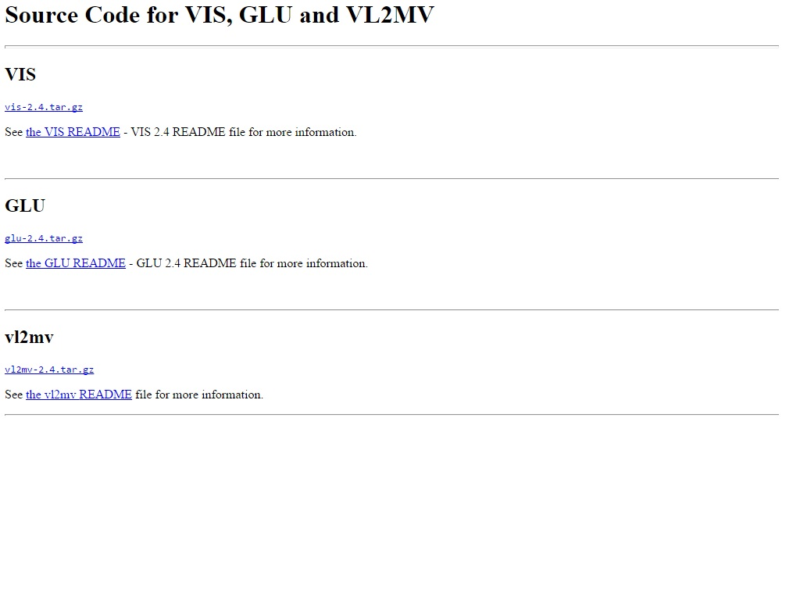
Getting VIS

Slide 5
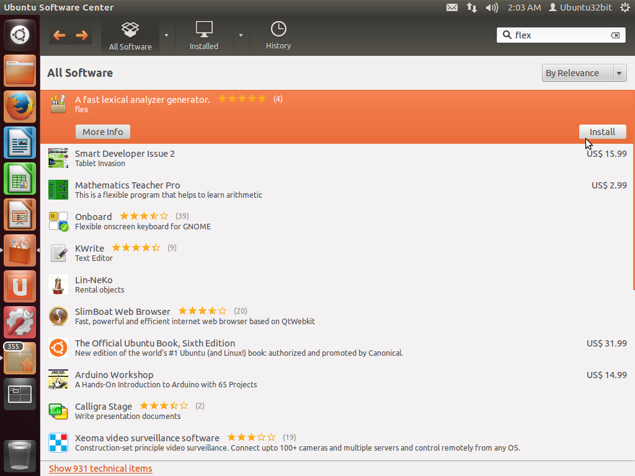
Install Flex and Bison
Goto software center and download the packages FLEX and BISON

Slide 6
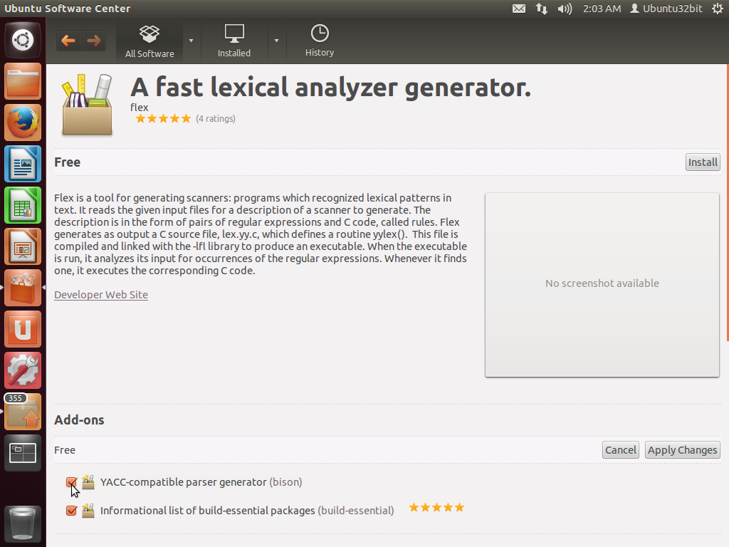
Install Flex and Bison

Slide 7
VIS Installation
Place all the downloaded tar files in a folder and extract all the files.
Open terminal and change the working directory to the folder in which the files are placed
Goto GLU folder and type the following commands
./configure make sudo make install

Slide 8
VIS Installation
Next goto VIS folder and type the following commands
./configure make sudo make install
Finally goto VL2MV folder and type the above commands.
This completes the installation and type vis in the terminal to run vis.

